Slide 1











Module 3: Digital Systems

Slide 2





6. flipflops

Slide 3
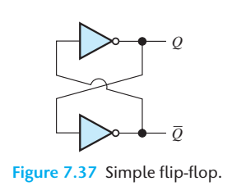




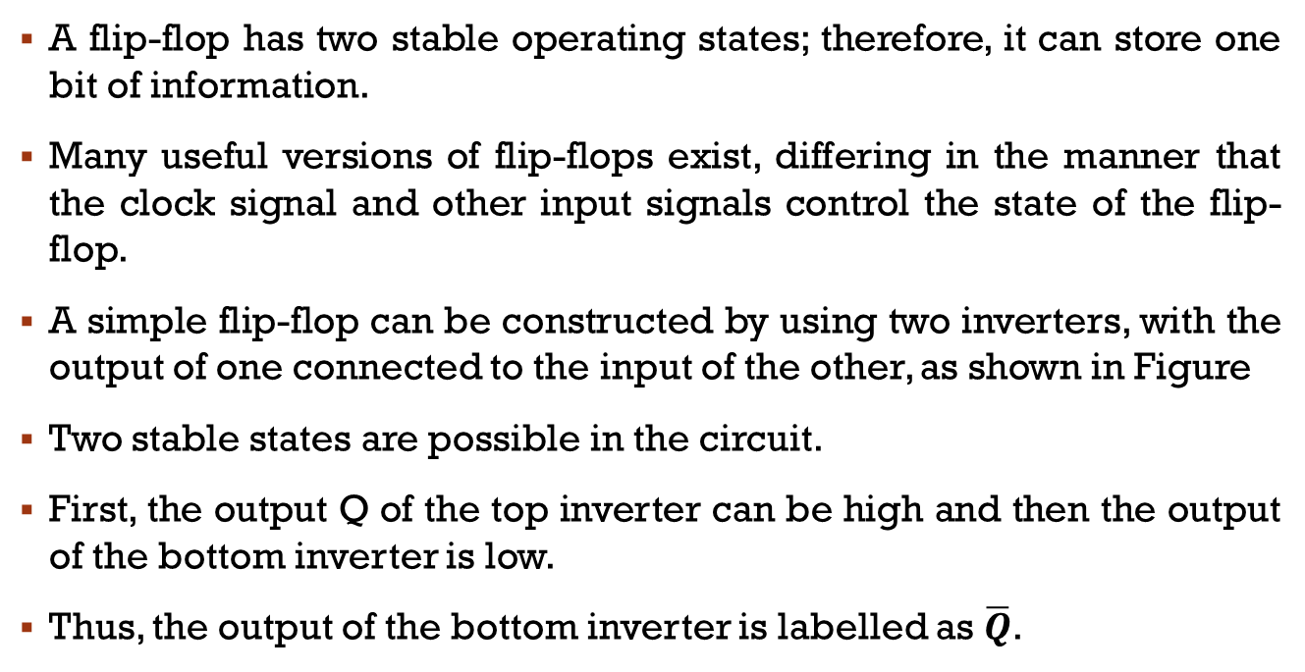



Flipflop
A flip-flop has two stable operating states; therefore, it can store one bit of information.
Many useful versions of flip-flops exist, differing in the manner that the clock signal and other input signals control the state of the flip-flop.
A simple flip-flop can be constructed by using two inverters, with the output of one connected to the input of the other, as shown in Figure
Two stable states are possible in the circuit.
First, the output Q of the top inverter can be high and then the output of the bottom inverter is low.
Thus, the output of the bottom inverter is labelled as $\overline{Q}$.

Slide 4
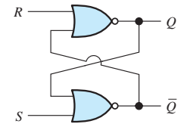
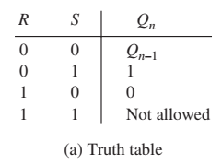
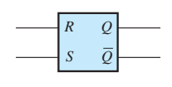
























SR Flip-Flop
The simple two-inverter circuit of Figure is not very useful because no provision exists for controlling its state.
A more useful circuit is the set-reset (SR) flip-flop, consisting of two NOR gates, as shown in Figure.

Slide 5




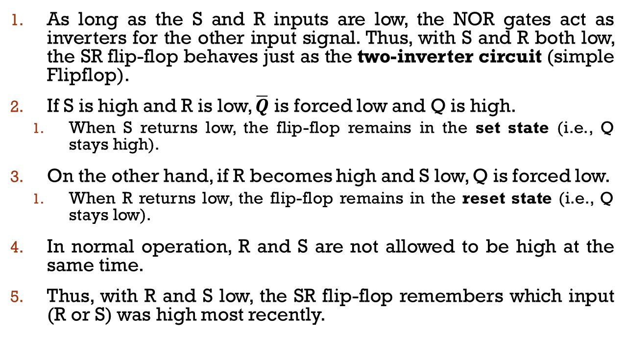




SR Flipflop
As long as the S and R inputs are low, the NOR gates act as inverters for the other input signal. Thus, with S and R both low, the SR flip-flop behaves just as the two-inverter circuit (simple Flipflop).
If S is high and R is low, $\overline{Q}$ is forced low and Q is high.
When S returns low, the flip-flop remains in the set state (i.e., Q stays high).
On the other hand, if R becomes high and S low, Q is forced low.
When R returns low, the flip-flop remains in the reset state (i.e., Q stays low).
In normal operation, R and S are not allowed to be high at the same time.
Thus, with R and S low, the SR flip-flop remembers which input (R or S) was high most recently.

Slide 6
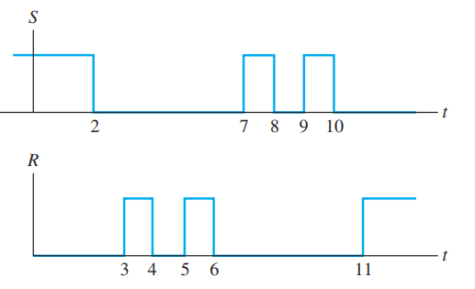
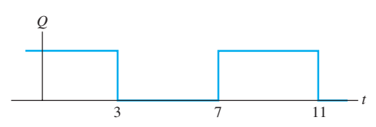
Example 1
The waveforms present at the input terminals of an SR flip-flop are shown in Figure

Slide 7



















Edge-Triggered Flip-Flops
The edge-triggered circuits respond to their inputs only at a transition in the clock signal.
At the clock transition, the flip-flop responds to the inputs present just prior to the transition.
If the clock signal is steady, either high or low, the inputs are disabled.
At the clock transition, the flip-flop responds to the inputs present just prior to the transition.
Positive-edge-triggered circuits respond when the clock signal switches from low to high.
Negative-edge-triggered circuits respond on the transition from high to low.
The positive-going edge of the clock is also called the leading edge, and the negative-going edge is called the trailing edge.

Slide 8
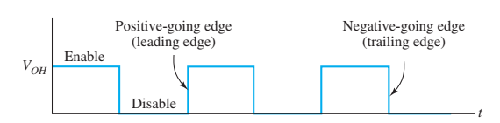
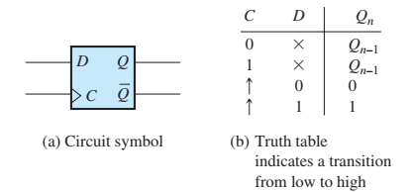
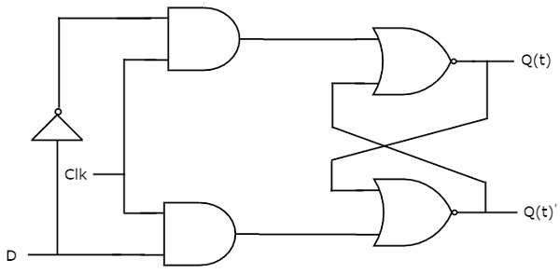

















D flip-flop
An example of an edge-triggered circuit is the D flip-flop, which is also known as the data flip-flop.
Its output takes the value of the input that was present just prior to the triggering clock transition.
Note, the symbols in the clock column of the truth table, indicating transitions of the clock signal from low to high.

Slide 9
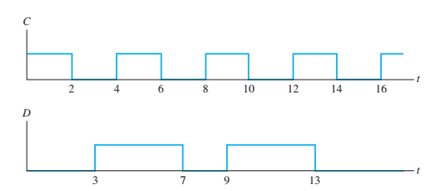
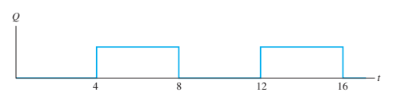
Example 2
The input signals to a positive-edge-triggered D flip-flop are shown in Figure. Sketch the output Q to scale versus time. (Assume that Q is low prior to t = 2.)

Slide 10
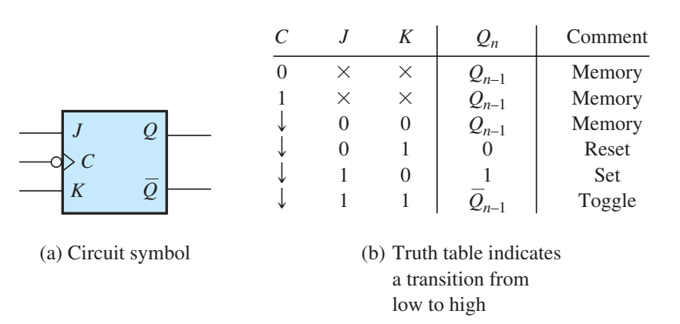
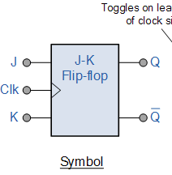
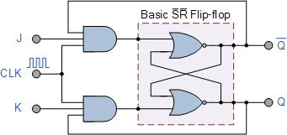








JK (Jack-Kilby) Flip-Flop
Its operation is very similar to that of an SR flip-flop except that if both control inputs (J and K) are high, the state changes on the next negative-going clock edge.
Thus when both J and K are high, the output of the flipflop toggles on each cycle of the clock–switching from high to low on one negative going clock transition, back to high on the next negative transition, and so on.

Slide 11







T Flip-flop
The name T flip-flop is termed from the nature of toggling operation.
The major applications of T flip-flop are counters and control circuits.
T flip flop is modified form of JK flip-flop making it to operate in toggling region.
Whenever the clock signal is LOW, the input is never going to affect the output state.
The clock has to be high for the inputs to get active.
Thus, T flip-flop is a controlled Bi-stable latch where the clock signal is the control signal.
Thus, the output has two stable states based on the inputs which have been discussed below.

Slide 12
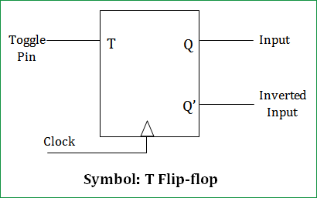
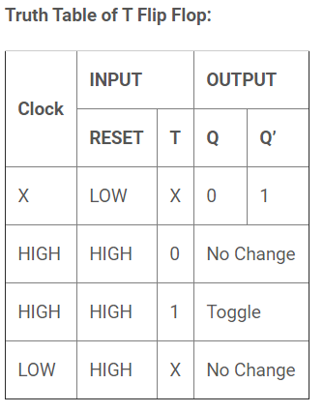
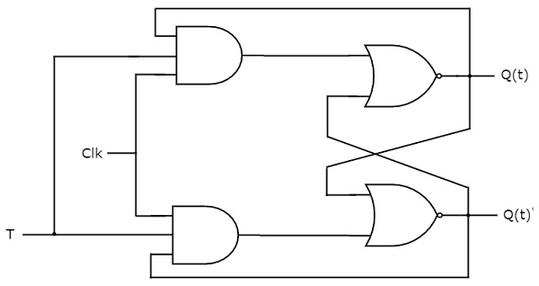









T flipflop
The T flip flop is the modified form of JK flip flop. The Q and Q’ represents the output states of the flip-flop.
According to the table, based on the input the output changes its state.
But, the important thing to consider is all these can occur only in the presence of the clock signal

Slide 13
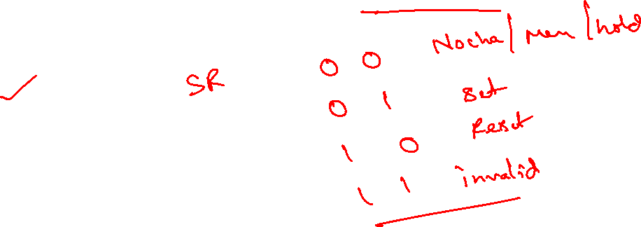
MCQ1
The truth table for an S-R flip-flop has how many VALID entries?
a) 1
b) 2
c) 3
d) 4
C

Slide 14
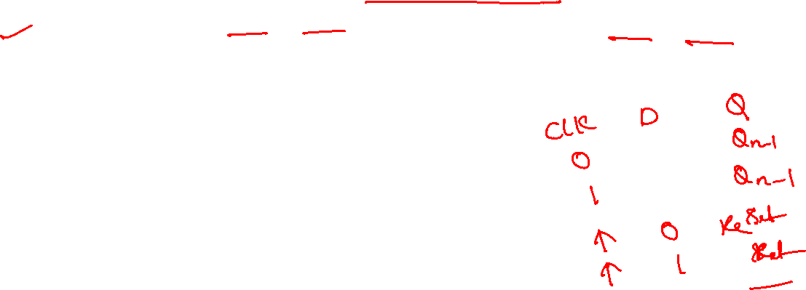
MCQ2
Which of the following is correct for a gated D-type flip-flop?
a) The Q output is either SET or RESET as soon as the D input goes HIGH or LOW
b) The output complement follows the input when enabled
c) Only one of the inputs can be HIGH at a time
d) The output toggles if one of the inputs is held HIGH
A

Slide 15
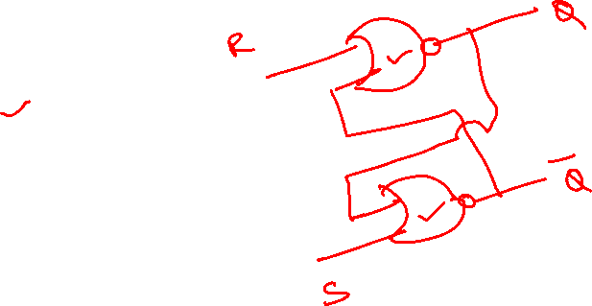
MCQ3
A basic S-R flip-flop can be constructed by cross-coupling of which basic logic gates?
a) AND
b) XOR
c) NOR
d) OR
C

Slide 16
MCQ4
A basic S-R flip-flop can be constructed by cross-coupling of which basic logic gates?
a) AND
b) XOR
c) NOR
d) OR
C

Slide 17
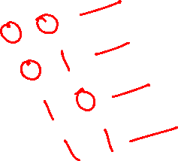
MCQ5
In S-R flip-flop, if Q = 0 the output is said to be ___________
a) Set
b) Reset
c) Previous state
d) Current state
B

Slide 18

MCQ6
How many types of flip-flops are?
a) 2
b) 3
c) 4
d) 5
C

Slide 19
MCQ7
What is one disadvantage of an S-R flip-flop?
a) It has no Enable input
b) It has a RACE condition
c) It has no clock input
d) Invalid State
D

Slide 20
MCQ8
The characteristic of J-K flip-flop is similar to _____________
a) S-R flip-flop
b) D flip-flop
c) T flip-flop
d) Gated T flip-flop
A

Slide 21
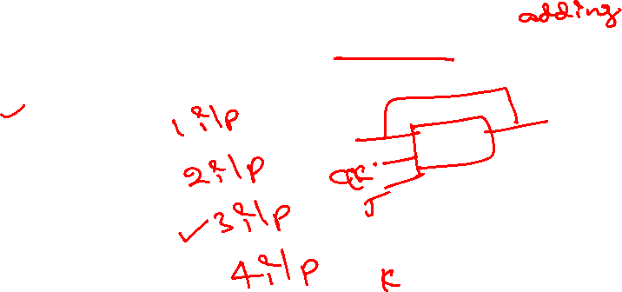
MCQ9
A J-K flip-flop can be obtained from the clocked S-R flip-flop by augmenting ___________
a) Two AND gates
b) Two NAND gates
c) Two NOT gates
d) Two OR gates
A

Slide 22
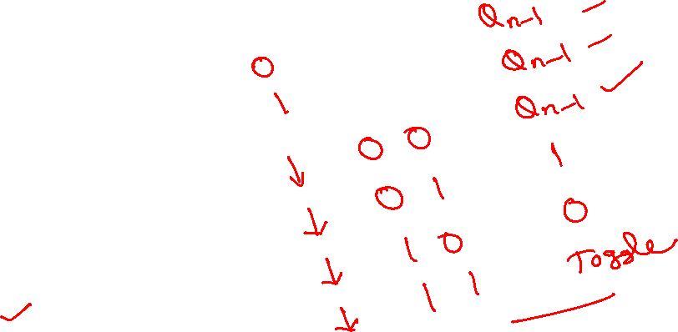
MCQ10
How is a J-K flip-flop made to toggle?
a) J = 0, K = 0
b) J = 1, K = 0
c) J = 0, K = 1
d) J = 1, K = 1
D

Slide 23

MCQ11
In J-K flip-flop, “no change” condition appears when ___________
a) J = 1, K = 1
b) J = 1, K = 0
c) J = 0, K = 1
d) J = 0, K = 0
D

Slide 24
MCQ12
On a J-K flip-flop, when is the flip-flop in a hold condition?
a) J = 0, K = 0
b) J = 1, K = 0
c) J = 0, K = 1
d) J = 1, K = 1
A

Slide 25
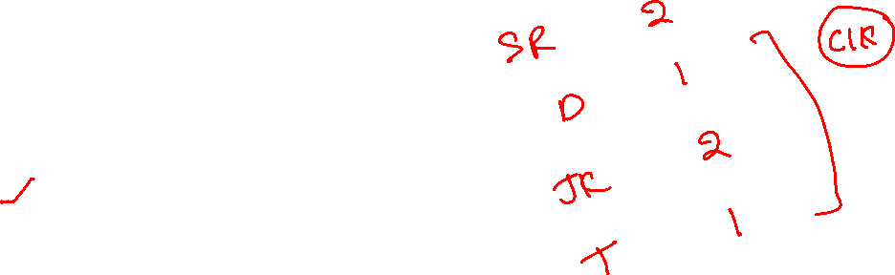
MCQ 13
The D flip-flop has _______ input.
a) 1
b) 2
c) 3
d) 4
A

Slide 26
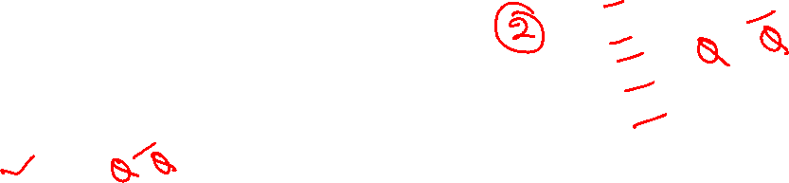
MCQ 14
The D flip-flop has ______ output/outputs.
a) 2
b) 3
c) 4
d) 1
A

Slide 27

MCQ 15
In D flip-flop, D stands for _____________
a) Distant
b) Data
c) Desired
d) Delay
B

Slide 28
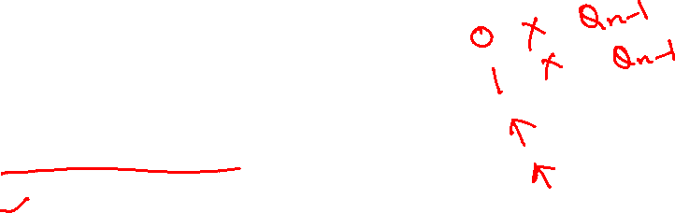
MCQ 16
In D flip-flop, if clock input is LOW, the D input ___________
a) Has no effect
b) Goes high
c) Goes low
d) Has effect
A

Slide 29

MCQ 17
In a J-K flip-flop, if J=K or K=J the resulting flip-flop is referred to as _____________
a) D flip-flop
b) S-R flip-flop
c) T flip-flop
d) S-K flip-flop
C

Slide 30
MCQ 18
The flip-flop is only activated by _____________
a) Positive edge trigger
b) Negative edge trigger
c) Either positive or Negative edge trigger
d) Sinusoidal trigger
C

Slide 31

MCQ 19
The flip-flops which has not having any invalid states are _____________
a) S-R, J-K, D
b) S-R, J-K, T
c) J-K, D, S-R
d) J-K, D, T
D

Slide 32
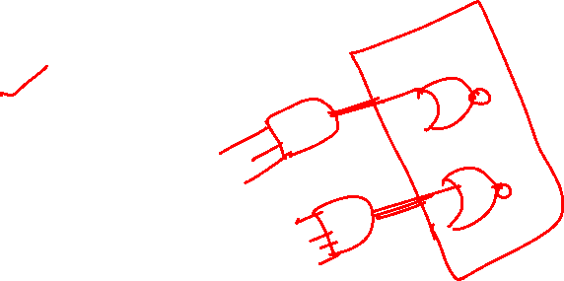
MCQ 20
For realisation of JK flip-flop from SR flip-flop, the input J and K will be given as ___________
a) External inputs to S and R
b) Internal inputs to S and R
c) External inputs to combinational circuit
d) Internal inputs to combinational circuit
A

